Slide 1
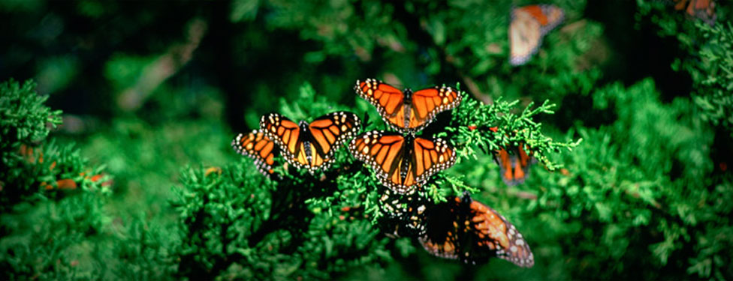
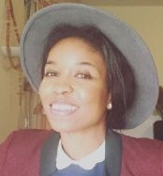
FINPA NEWS
Vol. 1.
Issue 1.
June /July 2016
A Newsletter for Nature lovers
Hi, welcome to the first edition of FINPA Newsletter. This is a quarterly news for all Nature-lovers & those whom nature has loved. FINPA News borders around, Protection and Conservation of natural resources - flora and fauna, Environmental Education, Sustainable Development. ‘We have met the enemy and the enemy is us'. Walt Kelly. we truly are the enemies of nature.
FINPA NEWS
Issued 4 times a year as an official publication of Finima Nature park.
Opinions are those of the writers and not necessarily the organization as a whole.
Office and Library
Finima Nature park, Finima, Bonny Island, Rivers State.
Phone: 08099889704
Email: finimanaturepark@gmail.com
Website: www. finimanaturepark.com
Facebook: finimanaturepark
Instagram: finimanaturepark.
Office Administrator ---------------Dagogo Brown
Outreach / Engagement Officer – Festa Eto
Field Supervisor ---------------------Sule Amuju
Hours: 8:00am – 5:00pm Mon – fri
Finpa News
Newsletter Editor ------------ Festa Eto
Email: finimanaturepark@gmail.com
Editorial Committee: Festa Eto
Edith Etor
Tolu Mafa - Attoye
for submission of articles, write-ups, volunteering, Email : finimanaturepark@gmail.com
Thank you to all our Supporters and Sponsors.
Our society, over the years has become a ‘USE & DUMP’ society. We TAKE, DESTROY, FIGHT and take some more without leaving a little or giving back for future needs. A time, which I feel is definitely at hand will come when there would be nothing left for our kids except memories....We all need to re-strategize and find ways to give back to ‘mother nature’ before she comes back to haunt us…which as I write this, she has started already. The ‘Earth provides enough to satisfy every man’s needs, but not every man’s greed’…Mahatma Gandhi – 1869-1948
Dear readers, this maiden Edition of FINPA newsletter has a lot of goodies for you. This includes; Conservation Club programme, tree nursery & herb garden, pictures and lots more. I am certain you all would love it. Do check our social media page for events /programs for more information.
On behalf of the editorial team, I am grateful to all who contributed articles/pictures and those who helped make this newsletter a huge success.
Have you been to the nature park? Then share with us your own experience. Please do send your articles/pictures through our mail address or in person at the resource center Finima nature park.
GREEN KIDS Conservation CLUB.
The Finima nature park has begun a Green kids Club in four schools so far.
The GREEN KIDS club is targeted at kids within the age-group, 6-10 years. Its designed to help kids learn more on the important role they play in protecting ‘Our Earth’. It features an engaging and interactive format that invites kids to connect with nature, build their understanding of real life environmental issues such as; climate change, pollution, deforestation, endangered fauna and flora affecting our world today, be empowered to take action and help PROTECT, CONSERVE our ecosystem for a more sustainable future. Where else can one advocate for the sustainability of our environment, if not with our kids?.
So what are you waiting for?!!!!
Do you feel you and your child can make a positive difference in our environment instead of being passive? Join us today!!!!
The Finima Nature Park is a land grand held in Trust for Finima People supported by Nigeria Liquefied Natural Gas (NLNG) and is managed by the Nigerian Conservation Foundation (NCF), an NGO. To help preserve and protect our flora and fauna for a sustainable future. VOLUNTEER today! Make a difference in OUR ENVIRONMENT!!!!

Slide 2
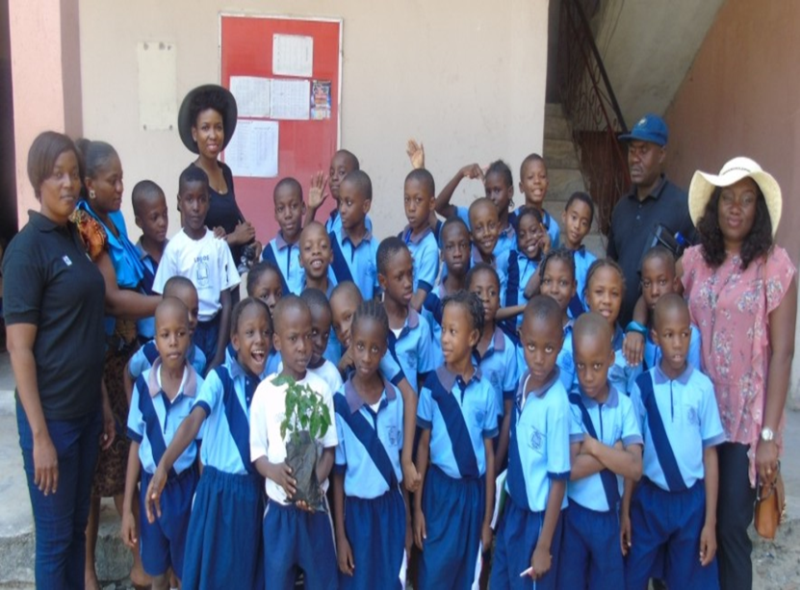
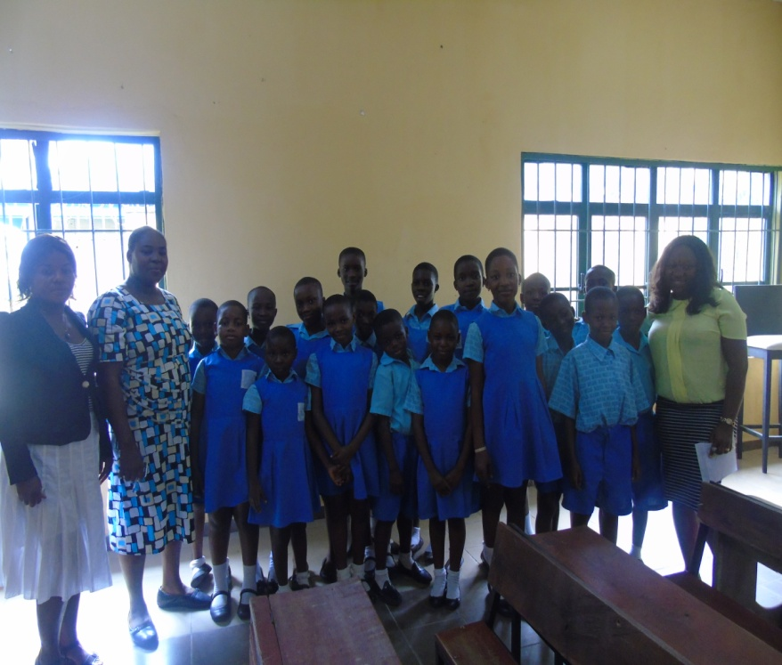
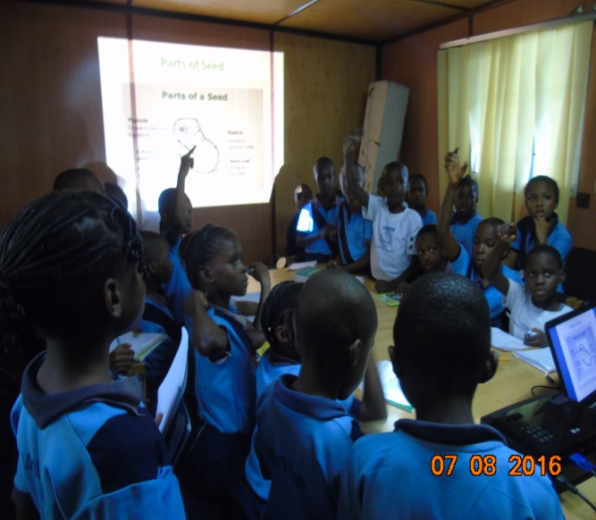
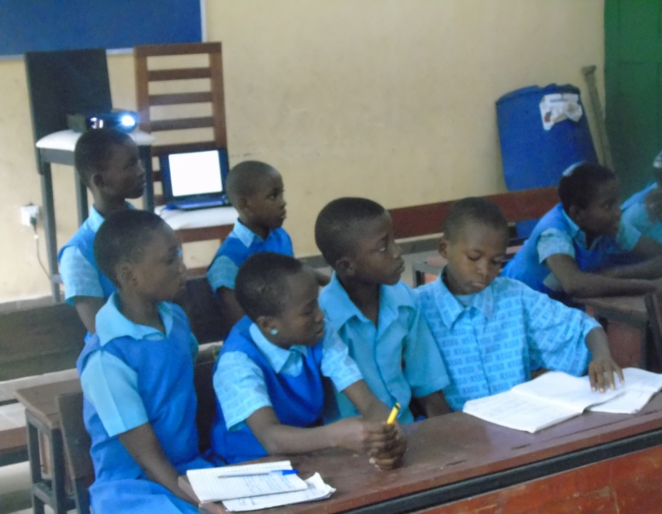
Green Kids Club
Logos International School Green Kids Club
The clubs in each school are undergoing an ‘Every Child a Seed’ programme where each child contributes to his/her environment by growing a herb garden and tree planting at their school.
‘He that plants trees loves others besides himself…Thomas fuller...
All pictures, videos are uploaded on our Facebook page and website. Do not forget to like.
Want to volunteer? Call our office line, send us a mail or Come to the Resource center at Finima Nature Park.
Green kids club of Community Primary School, Finima.
A cross section of the Green Kids Club of receiving lectures.
Page 2 FINPA News Vol. 1, Issue 1: July, 2016

Slide 3
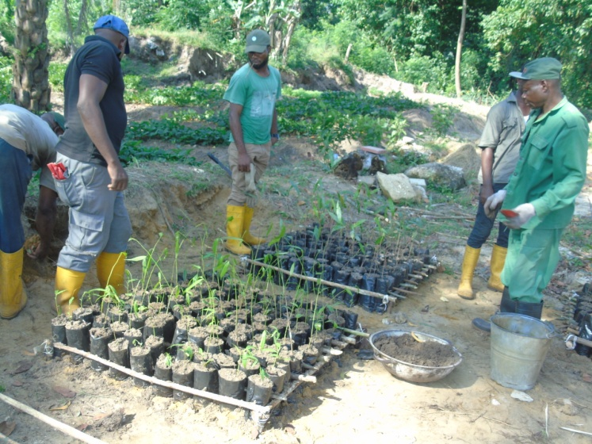
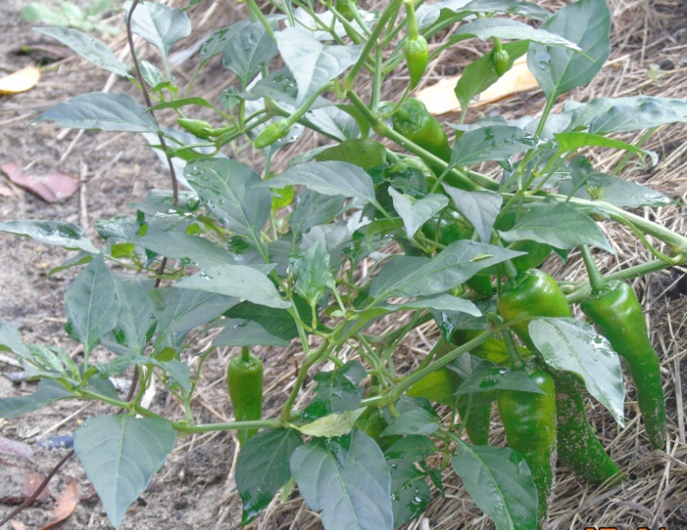
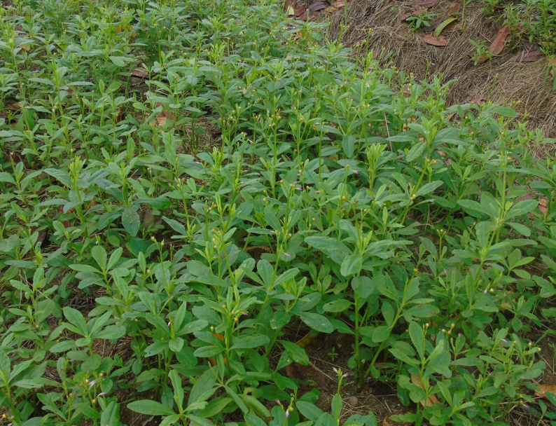
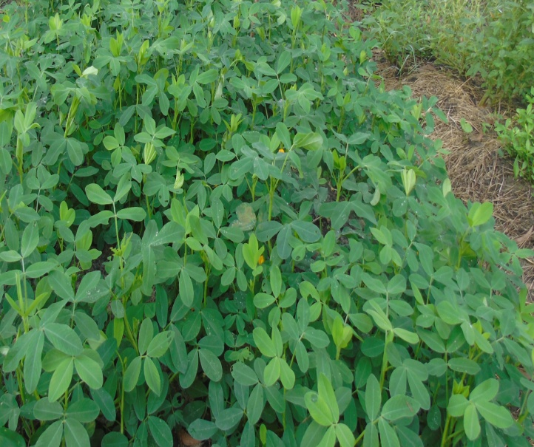
Tree Nursery
Nursery of mangrove and tree plants native to Bonny Island has begun at the park. Native plants are well adapted to the climatic conditions of their locality and are rarely invasive. Tree Planting is a necessity in every society.
Join our Park Rangers Quarterly (Sept) and lets go ‘A Tree Planting’. Come drop seeds / seedlings at Finima Nature park and lets go ‘a tree planting’.
‘Only when the last tree has died and the last river been poisoned and the last fish been caught will we realize we cannot eat MONEY….Cree Indian Proverb
Herb Garden
Yeasss!!! Our herb garden is fruiting and harvest time is here. Our vegetables are free from harsh chemical pesticides, herbicides and also fertilizers. Before we buy/ eat vegetables, we ought to know the source. Our herb garden is full of water leaf, pumpkin leaf, African peppers, spring onions, you just name it.
Come and get your fresh vegetables from Finima nature park. We don’t have the vegetables you eat? Send us a mail, call or visit the park
We are also organizing an ornamental garden. Do you have seeds of Ornamental plants? Come donate your flower seedlings.
Also, come let’s teach you how to garden. Contribute to your environment. Visit the Resource Center Finima Nature Park or call for more information.
Chilli Pepper
A Cross-section of Water leaf & Groundnut garden
Vol. 1, Issue 1: July, 2016 FINPA News Page 3

Slide 4
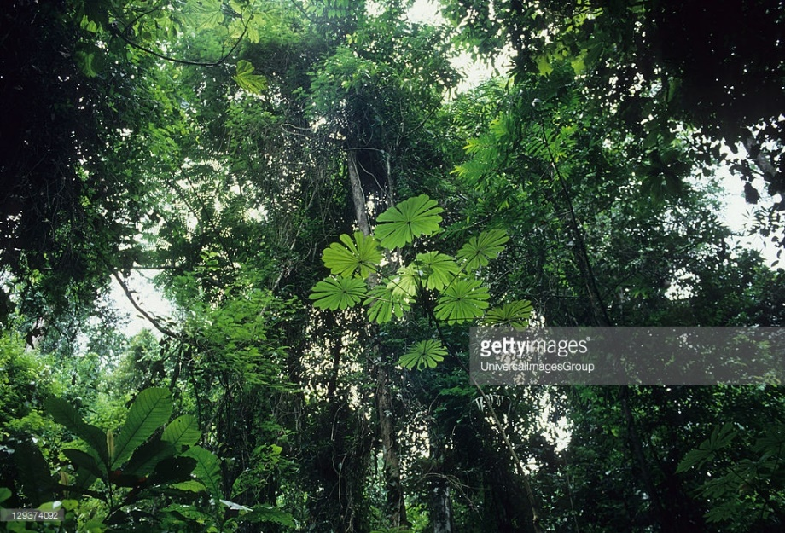
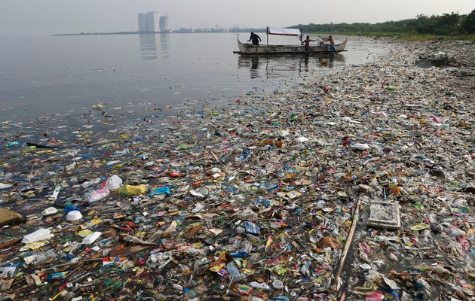
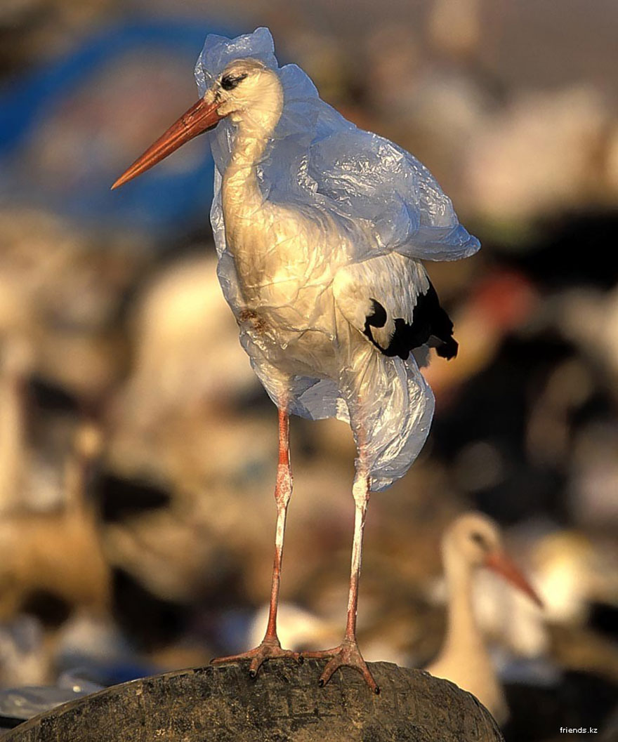
#DYK?Interesting facts about Our Environment
The Rainforest alone provides about 20% of the world’s Oxygen!!!!
We use wood faster than the rate at which trees can be re-grown.
More than half (50%) of the forest has been lost already, cut down, burned & bulldozed for man’s increasing population.
240,000 plastic bags are used every second of the day!!!!
It takes plastics about 400 years to break down and when they do, they release toxic chemicals.
#Crushplastics, #Reuseplastics #Recycleplastics
Every year over a million seabirds and 100,000 mammals die from eating plastics..
#whereisthelove, #plasticbagban
Page 6 FINPA News Vol 1, Issue 1; July 2016

Slide 5
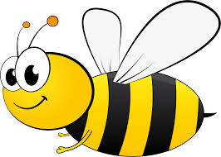
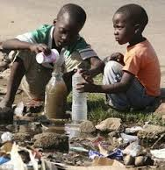
To make a tablespoon of honey, worker bees must visit about 4,000 flowers!!!
#Respectthehustle
Over 80% of sewage in poor developing countries goes straight into the rivers, lakes, sea without being cleaned first!!!!!
Everyday 5,000 children under the ages 5, die of diseases caused by drinking dirty water.
Your health & you
You burn more calories sleeping than you do watching television ( ok, now everyone go take a nap)
Holiday programme
Bird watching: Our next birding trip will be round the perimeter fence of NLNG
Date: 13th Aug, 2016.
Time: 8.00am
Venue: Resource Center, Finima Nature Park
Herb Gardening: Planting of herb
Date: 10th _ 11th Aug, 2016
Time: 9.am
Venue: Resource Center, Finima Nature Park.
Educate yourself, Learn how to garden, come along with seeds of your choice… let’s teach you how to make your own garden!!!!!!.
OPEN TO ALL YOUNG AND OLD……
Facebook
Instagram
E – Mail
Website
Copyright © 2016 Finima Nature Park, All Rights Reserved
Vol. 1, Issue 1; July, 2016 FINPA News Page 7

